Slide 1
Software Project Management
MARLA AKHI REDDY
13BCE1078

Slide 2
ACCIDENT MODULE

Slide 3
Components
Sensors
Mobile
On board Circuit

Slide 4
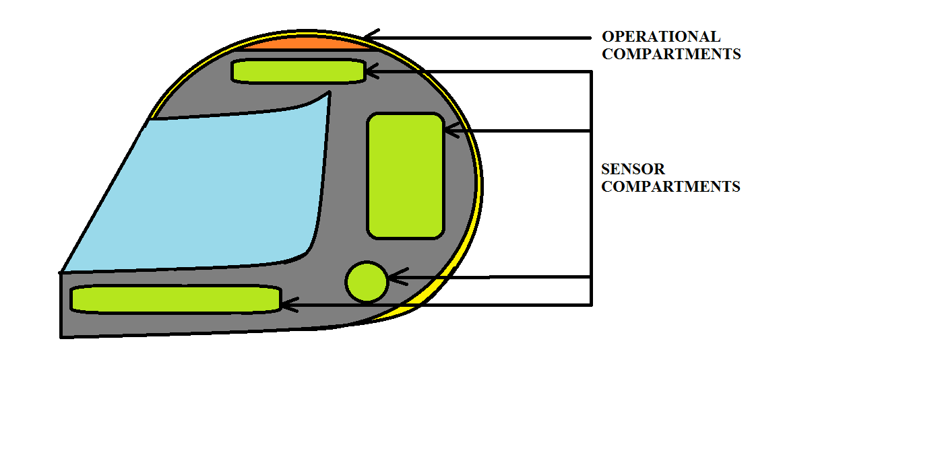
Design

Slide 5
How it works?
Sensors are placed at appropriate locations to get the pressure values when the accident happens.
Proper testing is done in scenarios to get the pressure values when accident occurs.
Appropriate locations should be found on the helmet so that at least one of the sensors gets the pressure so that accident is identified in all scenarios.

Slide 6
Cond
Thresold values are set for pressure sensors to trigger the mobile.
Once accident occurs and sensors read values greater than the thresold, mobile is triggered.
Mobile automatically calculates GPS location of the user through GPS in mobile and sends the location to cloud.
It is processed in cloud, and sent to appropriate hospital.

Slide 7
Then hospital responds by sending ambulance to that location.

